Slide 1

Kristu Jyoti College of Management and Technology,
Chethipuzha , Kurisummoodu P.O.,
Changanassery
Kottayam – 686 104
CHILD SAFETY WEARABLE DEVICE
Reg. No. 203242210992
Dr. Susheel George Joseph
Asst.Professor
Department of Computer Application
Anamika P.M
MCA, S
Department of Computer
Application

Slide 2
CONTENTS
Abstract
Introduction
Wearable Device
Working of System
Components
Architecture
Results
Advantages
Future Scope
Conclusion
References

Slide 3
ABSTRACT
Child safety is a major concern in any society due to the vulnerability of a child and consequently, higher
rates of crimes against children. With this issue on our hands, a smart wearable Internet of Things sensor
network for monitoring the environment of a child can be developed to help parents ensure the safety of
their children. It must also necessarily include amechanism for tracking the child. An advantage of this
wearable device is that, according to its design, it can be accessed from any mobile device and does not
mandate a lot of technical knowledge from the user to operate. The purpose of this device is to facilitate
the guardian or parents in locating their child with ease and ensuring its well-being. The basic
mechanism of this system involves monitoring the environment through sensor nodes, acquiring
real-time data and transmitting this data to a cloud server. The data can be accessed by users through
a web-based interface present on this cloud server. The wearable also functions to send alerts tothe user
through a mobile application in case an emergency condition is detected by it. The design of this
model involves developing a medium for communication between the parent/guardian and the child’s
wearable device.

Slide 4
INTRODUCTION
Child safety is a major concern in any society due to the vulnerability of a child and consequently, higher rates of crimes against children. With this issue on our hands, a smart wearable Internet of Things sensor network for monitoring the child can be developed to help parents ensure the safety of their children.

Slide 5
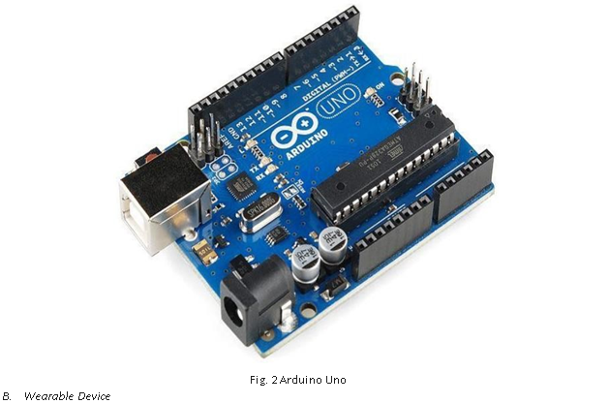
WEARABLE DEVICE
The wearable loT device tasked with acquiring various data from the all the different modules connected.
It comprises of Arduino Uno based on the ATmega328P microcontroller.

Slide 6
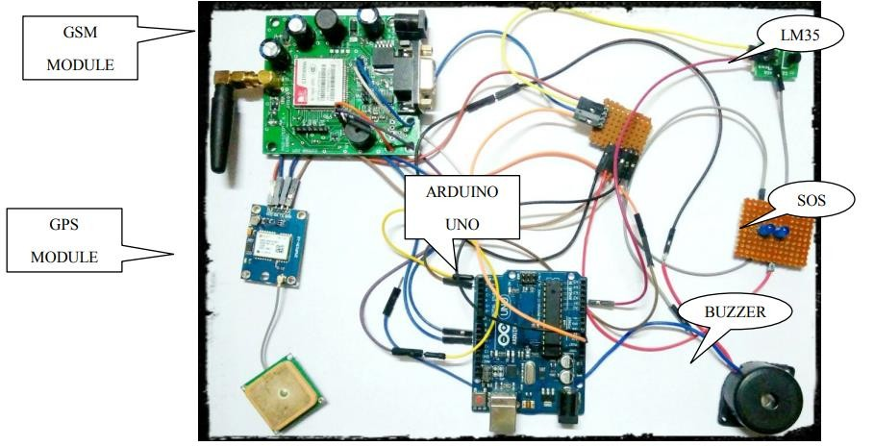
WORKING OF SYSTEM
This describes about safety and security to Children through various IOT technologies which consists of an Arduino Controller , and sensors .
sensors such as temperature,Flex Sensor, pulse rate sensor.
Alarm Buzzer,Hidden Camera,Touch Sensor
Parents send an SMS using some keywords such as temperature,location,SOS,buzz etc
This results in knowing the location of their child.

Slide 7
COMPONENTS
Arduino Uno
Temperature Sensor
GPS Location Sensor
SOS Light and Alarm Buzzer
GSM Module

Slide 8
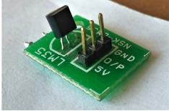
Temperature Sensor
It gives an output proportional to the temperature.
Its response time was upto 40 to 60 seconds.
In order to measure the temperature of the child, a LM35 sensor is used.

Slide 9
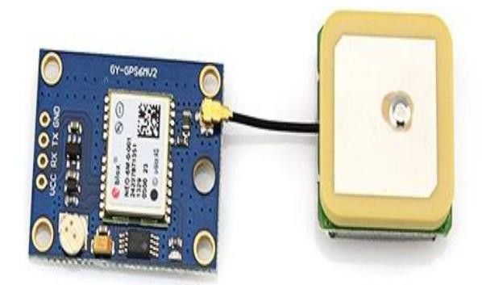
GPS Location Sensor
The connections between the Arduino Uno and the GPS module established like the connections with GSM module. It has a low power consumption and small size, which is very compact.

Slide 10
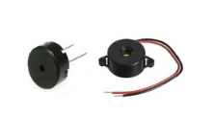
SOS Light and Alarm Buzzer
upon sending an sms 'SOS' or 'Buzz',this would trigger or alarm to perform an output function instead of providing measurements back to the user's mobile such as Scenarios of other like GPS,GSM OR SENSORS etc.

Slide 11
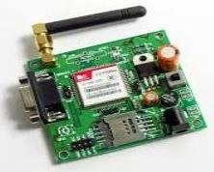
GSM Module
GSM is a standard developed by ETSI to describe protocols for Second Generation digital cellular network used by phone.GSM can accept any GSM network operator SIM Card and act just like a mobile phone with its unique phone Number.

Slide 12
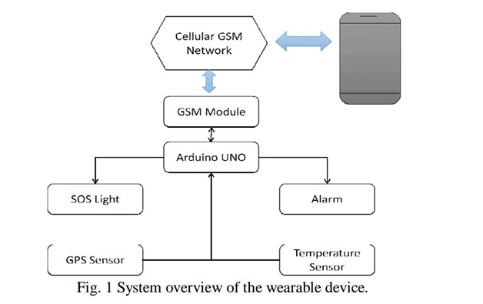
ARCHITECTURE

Slide 13
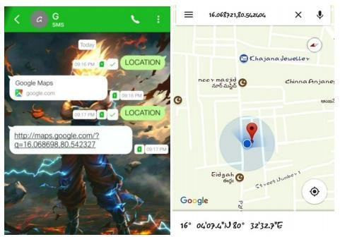
RESULTS
GPS Location Sensor
Upon testing the wearable device multiple times with repeated SMS texts. The GPS location sensor was able to respond back with precise latitude and longitude coordinates of the wearable device to the user's cellphone, which then the user would click on the received Google maps URL which would, in tum, open the gmaps app or any default browser and display location

Slide 14
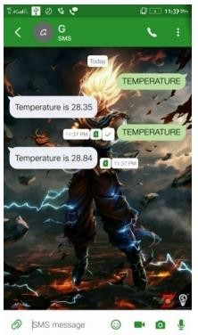
Temperature Sensor
Similar to the GPS location sensor, the Temperature sensor were tested multiple times under different temperatures. The sensor performed exceptionally well to the test performed. The response time to receive a response back to the keyword "TEMPERATURE" was under a minute.

Slide 15
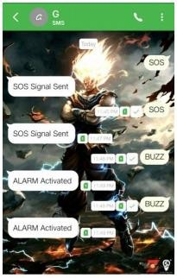
SOS light and Alarm Buzzer
Upon sending an SMS either "SOS" or "BUZZ," this would trigger the light or buzzer to perform an output function instead of providing measurements back to the user's mobile such as in the scenario of the other sensors. Upon receiving the proper keywords, the SOS light and Alarm Buzzer would first perform the particular task of flashing the SOS light and sounding a alarm which can take a little longer than their sensor counterparts

Slide 16
ADVANTAGES
Easy availability and affordability
Tracking made easy
Watches over your kids
Guarantees peace of mind to parents

Slide 17
FUTURE SCOPE
Child's surroundings can be located with the help of accurate and precise real-time location. Surrounding environment temperature, SOS light along with Distress buzzers are provided in this system . This helps in locating their child .
The idea behind the Android app has been derived from having an automated bot to respond to text message responses from the user. It will provide the user with predefined response options at just the click of a button.

Slide 18
CONCLUSION
The child safety wearable device is capable of acting as a smart Iot device.
It provides parents with the real time location,surrounding temperature and SOS light for their child’s surroundings.
More power efficient model can capable of holding the battery for a longer time.

Slide 19
REFERENCES
Smart IOT Device for Child Safety and Tracking: M Nandini Priyanka, S Murugan, K
N H Srinivas, T D S Sarveswara rao, E Kusuma Kumari, " Smart IOT Device for Child
Safety and Tracking", International Journal of Innovative Technology and Exploring
Engineering (IJITEE) ISSN: 2278-3075, Volume-8 Issue-8 June, 2019.
Nwankwo Nonso Prince "Design and implementation of microcontroller based short
message service control system," Internet Technology and Secured Transactions (ICITST),
2013 8th International Conference for, London, 2013.
Kumar, D. and Anggarwal, S, ”Analisis of Woman Safety in Indian Cities Using
MachineLearning on Tweets,” Amity International Conference on Artificial Intelligence,
vol. 1, pp. 159-162, 2019, doi: 10.1109/AICAI.2019.8701247.
Ahir, S., Kapadia, S., Chauhan, J., and Sanghavi, N, “The Personal Stun-A Smart
Device for Women’s Safety,” International Conference on Smart City and Emerging
Technology, vol.2, pp. 331-333, 2018, doi: 10.1109/ICSCET.2018.8537376.
Seth, D., Chowdhury, A., and Ghosh, S, “A Hidden Markov Model and Internet of Things
Hybrid Based Smart Women safety Device,” International Conference on Power, Energy, and
Environment: Towards Smart Technology, vol. 6, pp. 414-419, 2018, doi:
10.1109/EPETSG.2018.8658848

Slide 20
THANK YOU……!!!

